Slide 1
osteoporosis
Dr Saremi. BUMS, Assistant professor of rheumatology
@drzsaremi
www.drzeinabsaremi.ir

Slide 2
bone

Slide 3
Type of bone:
1) lamellar: cortical- cancellous
2) woven: healing- pathologic

Slide 7
epidemiology
Osteoporosis, a condition characterized by decreased bone strength,
Osteoporosis affects >10 million individuals in the United States, but only a small proportion are diagnosed and treated.

Slide 8
Osteoporosis-related fractures:
adulthood fractures of any bone that occur in the setting of trauma less than or equal to a fall from standing height, with the exceptions of fingers, toes, face and skull.

Slide 9
Classification
Primary:
Senile, F> M, low level of estrogen-
Fracture of forearm and vertebra
Secondary: drugs- systemic disease

Slide 10
Secondary
Endocrine: hypogonadism- thyrotoxicosis- …
Malabsorbtion status:
Drugs
disorder in Collagen metabolism
Others: RA- MM- RTA- COPD- ..

Slide 11
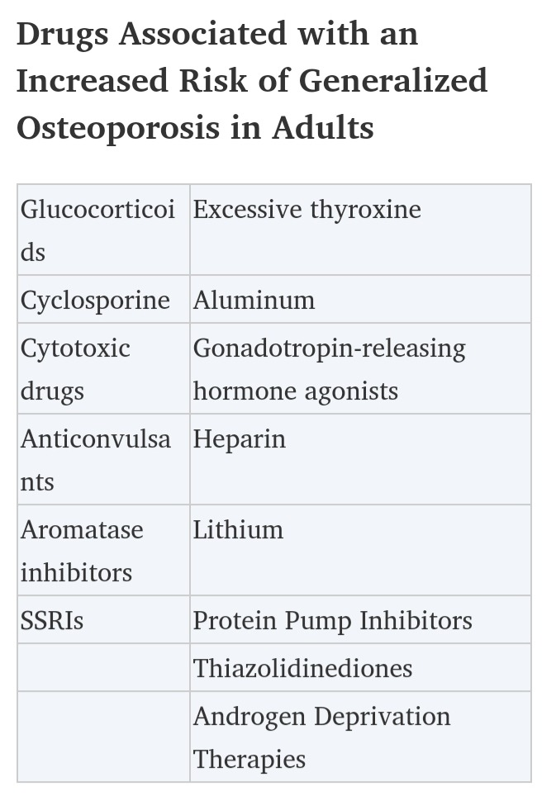

Slide 12
diagnosis
DXA is the most widely used method for measuring BMD because it gives very precise measurements at clinically relevant skeletal sites (ie, those with major clinical consequences when a fracture occurs).

Slide 17
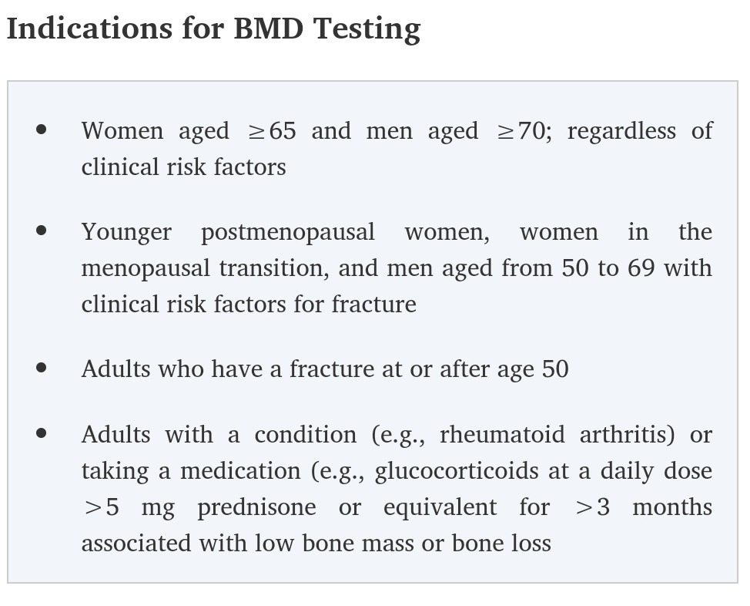

Slide 18
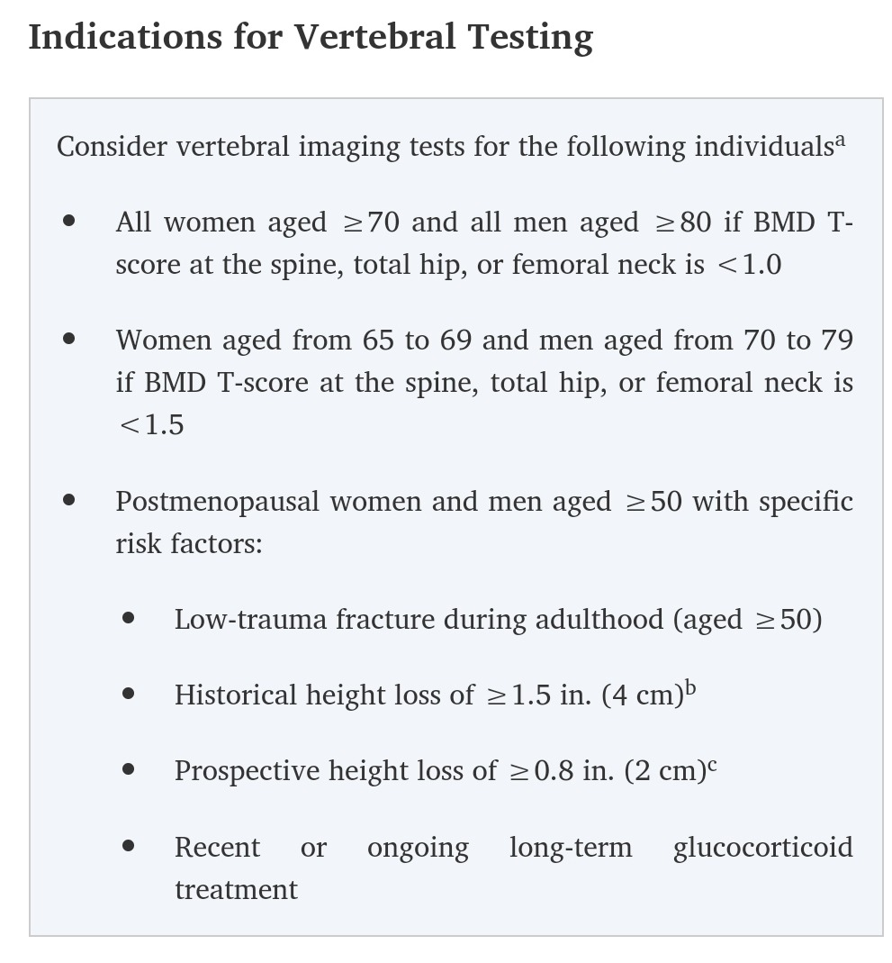

Slide 19
Clinical manifestation
Asymptomatic
Fracture
Deformity

Slide 20
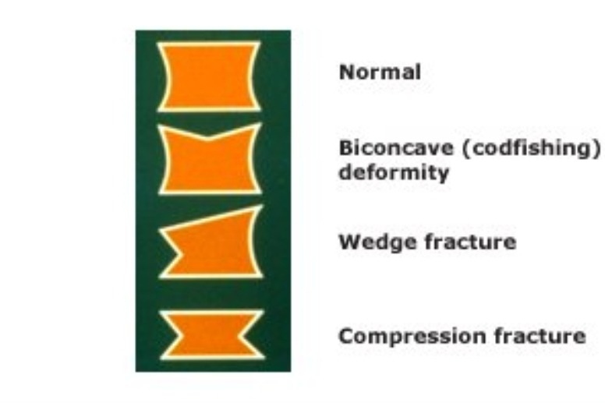

Slide 21
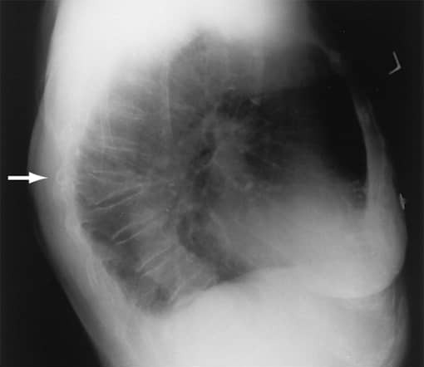

Slide 22
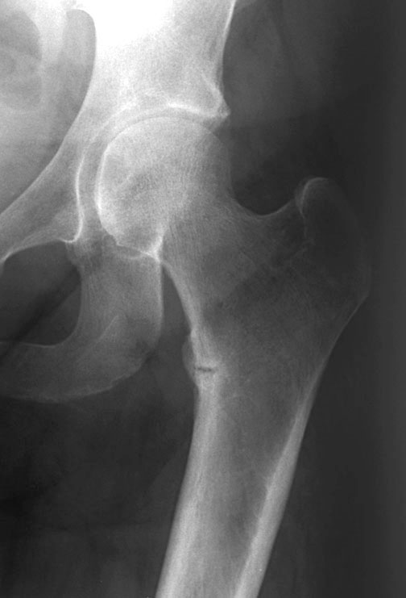

Slide 23
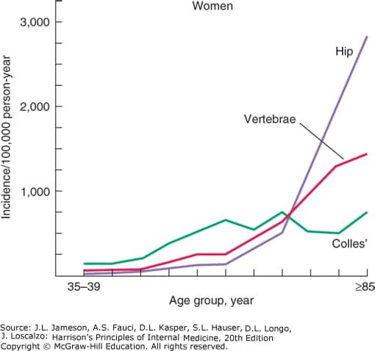

Slide 24
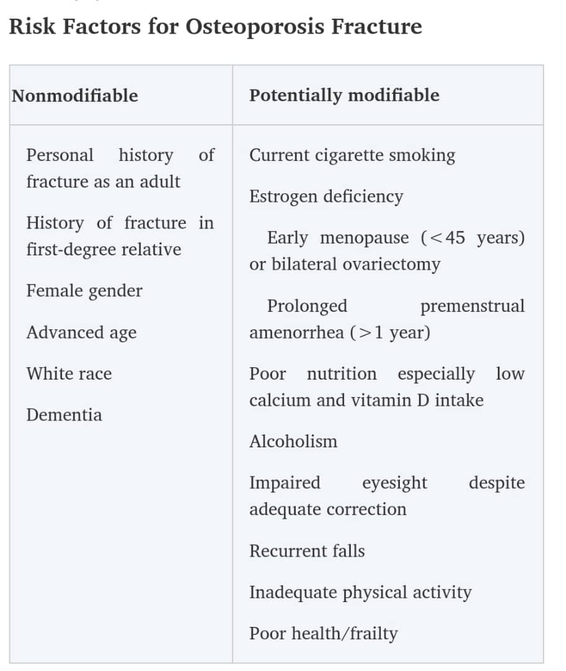

Slide 25
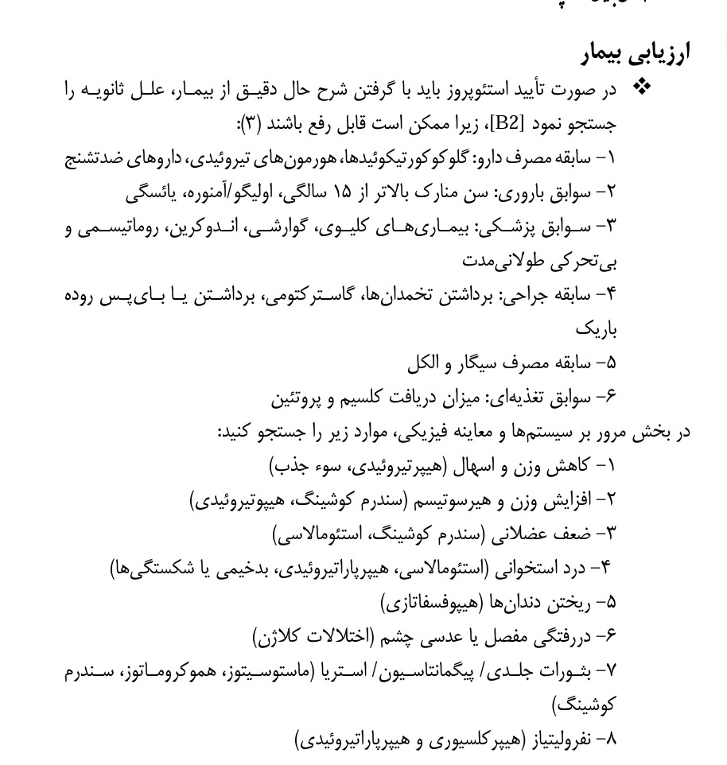

Slide 26
Treatment( non pharmacologic)
Exercise
Stop smoking
Stop excessive coffee

Slide 27
Treatment( pharmacologic)
VITAMIN D
Calcium
Anti resorbtive drugs: bisphosphonate- anti RANK L
osteoblastic drugs: PTH

Slide 33
Repeat BMD measurements
T score: -2 to -2.5: every 2 years
T score : -1.5 to -2: every 3-5 years
T score : -1 to -1.5 : every 10 yeaers

