Slide 1
Sjögren’s Syndrome
Dr Saremi. BUMS, Associated professor of rheumatology
@drzsaremi
www.drzeinabsaremi.ir

Slide 2
Chronic
Slowly progressing
Autoimmune disease
Lymphocytic infiltration of exocrine gland
Xerostomia and dry eye
Wide clinical spectrum

Slide 3
Primary VS Secondary SS

Slide 4
epidemiology
0.5- 1%
Middlie age woman
F/M: 9
5-20 % of other autoimmune disease

Slide 5
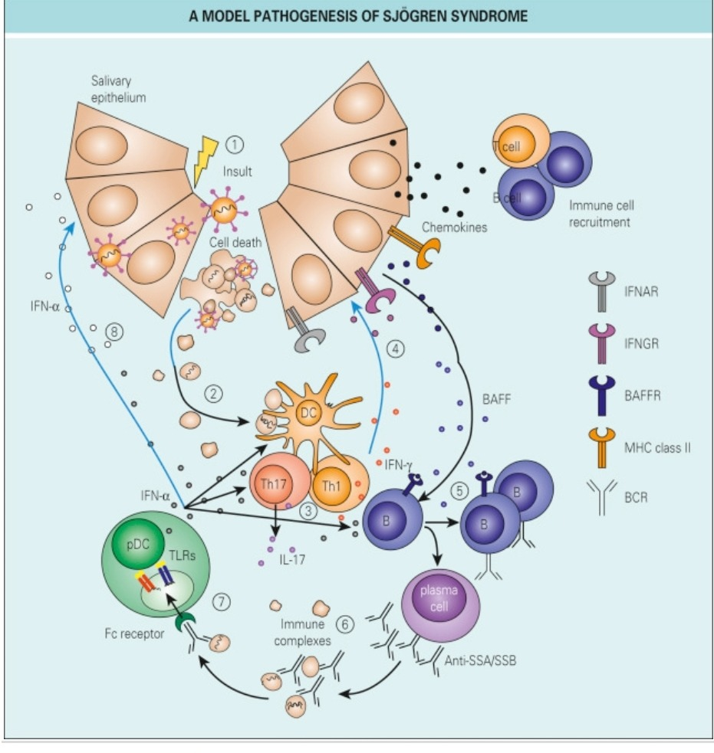
Etiopathology

Slide 6
Clinical manifestation

Slide 7
Bilateral parotid enlargement

Slide 8
dry nose, throat, and trachea (xerotrachea).
diminished secretion of the exocrine glands of the gastrointestinal tract leads to esophageal mucosal atrophy and atrophic gastritis.
Dyspareunia due to dryness of the external genitalia and dry skin also may occur.

Slide 11
Small vessel vasculitis in SS

Slide 12
Lung involvement in SS

Slide 13
Manifestations predicting the development of lymphoma
Persistent parotid gland enlargement
purpura
leukopenia
cryoglobulinemia
low serum C4 complement levels
autoantibodies (anti-Ro/SS-A, anti-La/SS-B)
ectopic germinal center formation in minor salivary glands

Slide 14
Laboratory finding
SS-A
SS-B
RF
Ig
ESR (70%)
Normochromic normocytic anemia
Low comlement

Slide 15
Diagnosis
(1) the patient presents with eye and/or mouth dryness,
(2) eye tests disclose keratoconjunctivitis sicca,
(3) mouth evaluation reveals dry oral mucosa, and/or
(4) the patient’s serum reacts with immunoglobulins (rheumatoid factors), Ro/SS-A, and/or La/SS-B autoantigens

Slide 16
Revised International classification criteria for SS
Ocular symptom
Oral symptom
Ocular sign: schirmer I , rose bengal score
Oral sign: sialometry, sialography,
Lib biopsy
Autoantibody
4 out of 6

Slide 17
Exclusion criteria:
past head and neck radiation treatment,
hepatitis C infection,
AIDS,
preexisting lymphoma,
sarcoidosis,
graft-versus-host disease,
use of anticholinergic drugs.

Slide 18
Eye tests

Slide 19
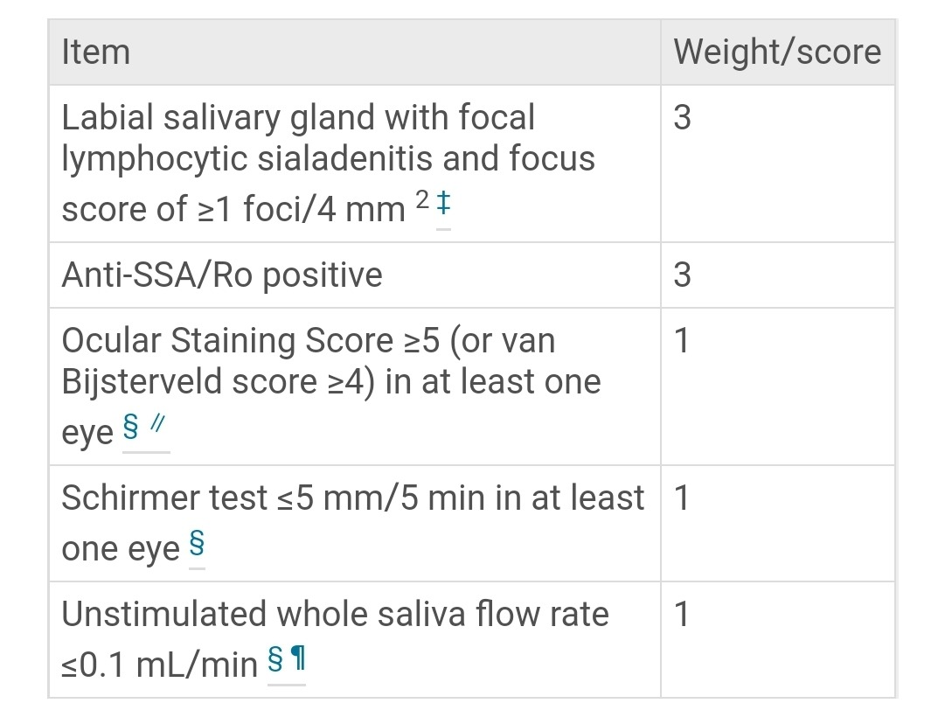
2016 ACR/EULAR classification criteria for primary Sjögren syndrome

Slide 20
Differential diagnosis
Sarcoidosis
HIV
( age- autoantibody- serology- pathology)

Slide 21
Differential diagnosis
Dry Eye:
Chronic conjunctivitis
Chronic blepharitis
Sjögren’s syndrome
Toxicity
Burns
Drugs
Impaired lacrimal gland function
…

Slide 22
Xerostomia
HCV- HIV
Drug
Psychologic
Diabetes mellitus
Amyloidoss
..

Slide 23
Parotid enlargement
Viral
Endocrine: acromegaly, gonadal hypofunction, diabetes,
Sarcoidosis
TB
….

Slide 24
