Slide 1
Shoulder pain

Slide 2
The shoulder is the most mobile joint in the
human body
Shoulder pain involves any pain in or around the shoulder joint
Shoulder pain is a most common MSK complain
is the most mobile joint in human b

Slide 3
Anatomy
History
Physical exam
Etiology
approach

Slide 4
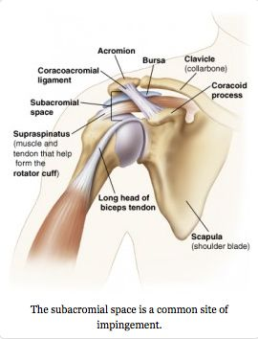

Slide 5
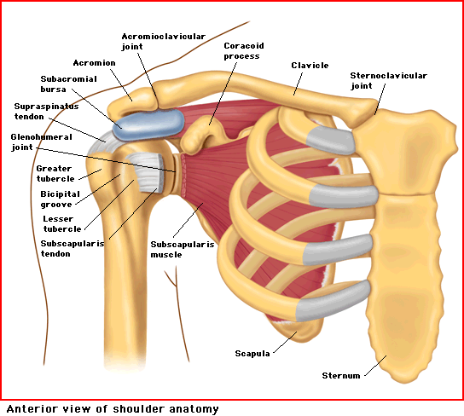
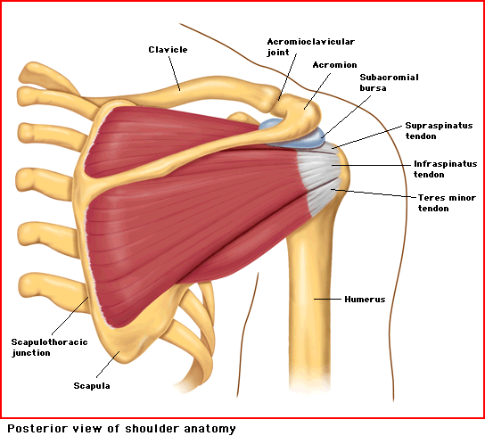
The Rotator Cuff Muscles
Rotator Cuff
Supraspinatus: Abduction
Infraspinatus: External rotation
Teres Minor: External rotation
Subscapularis: Internal rotation
Notes:
Supraspinatus tendon is what gets inflamed in RTC tendonitis

Slide 6
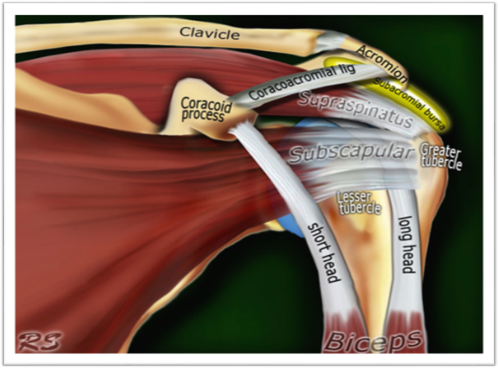

Slide 7
MSK Shoulder Pain Differential
Articular Causes
Glenohumeral (GH) and acromoclavicular (AC) arthritis
Ligamentous and labral lesions
GH and AC joint instability
Osseus: fracture, osteonecrosis, neoplasm, infection
Periarticular Causes
Chronic impingement and rotator cuff tendinitis
Bicep tendinitis
Rotator cuff and long biceps tendon tears
Subacromial bursitis
Adhesive capsulitis
Notes:
Narrow based on location of pain and age of patient, sport, trauma, etc
Neurologic causes, referred pain are other examples on the diff

Slide 8
Taking Your History
Age
Hand dominance
Occupation
Sports/physical activities
Trauma
Onset
Location
Character
Duration
Radiation
Aggravating/relieving factors
Night pain
Effect on shoulder function
Stiffness/restriction of movement
Grinding or clicking
Weakness
Numbness/tingling Pain
Notes:
Clues to tailor your differential

Slide 9
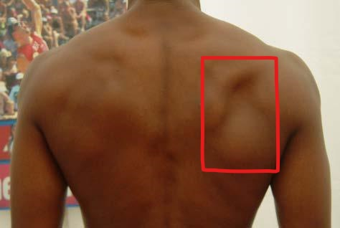
The Physical Exam
Inspection
Asymmetry
Bony deformity or abnormal contour
Muscle atrophy or bulge
Scapular winging
Notes:
Popeye, AC separation, muscle atrophy

Slide 10
poor posturealways using one hand or side of your body for writing
carrying a heavy bag
going about your daily activities
sedentary lifestyle
uneven hips
pinched nerve
flat feet
osteoporosis
shoulder injuries
weak or tight muscles
overuse or misuse of the shoulders
incorrect sleeping position or only sleeping on one side
using one side of the body to hold objects

Slide 11
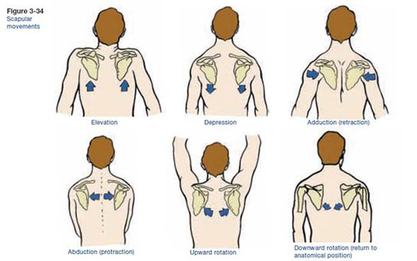
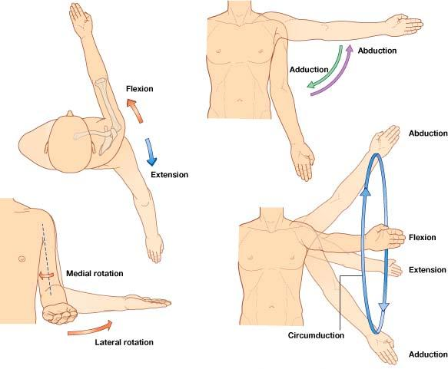
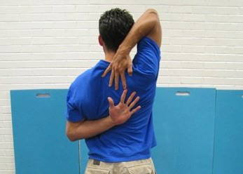
The Physical Exam
Range of Motion
Active
Passive
Scapular movement
Strength Testing
Notes:
Normal C7 and T7
Flexion – 180, Extension – 60, Abduction – 180, Adduction - 45
Internal 60-70, external 90
Compare biateral

Slide 12
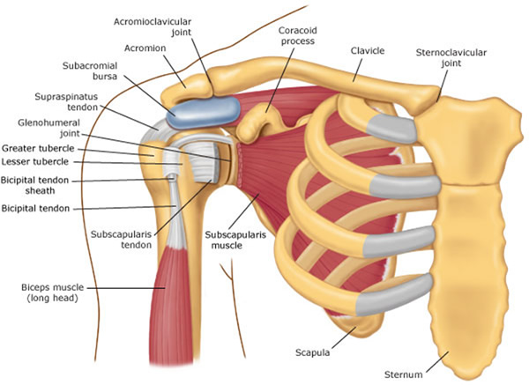
The Physical Exam
Palpation
AC, SC, and GH joints
Biceps tendon
Coracoid process
Acromion
Scapula
Notes:
Bursa – lubrication for RC

Slide 13
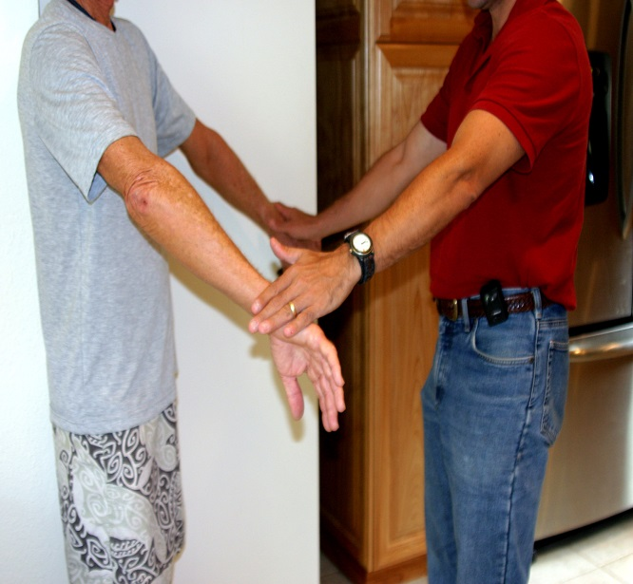
Special Tests
Rotator Cuff
“Drop-arm”
“Empty can,” push-off, and resistance testing
Impingement
Neer’s
Hawkins
Notes:
empty can – bring in like 30 degrees
Impingment – RC not intact, can’t prevent cephalad migration of humeral head; narrowing of space b/t acromion and RC; acromion impinges on RC and bursa causing pain

Slide 14
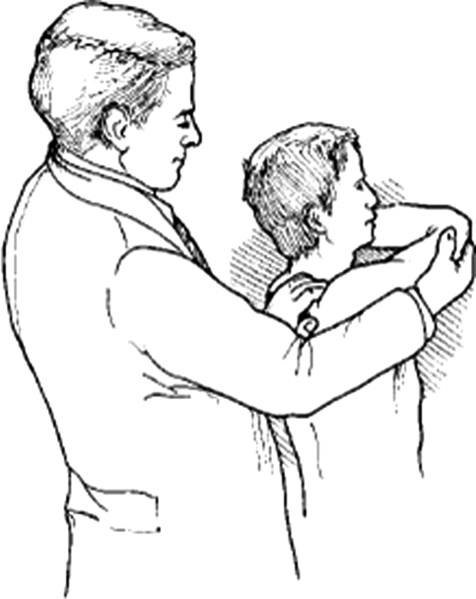
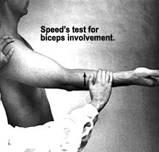
Special Tests
Biceps
Speed’s
Yergason’s
AC Joint
Cross-arm

Slide 15
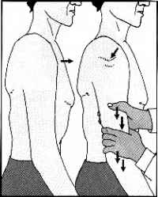
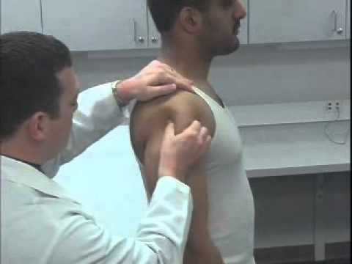
Special Tests
Shoulder Instability
Sulcus sign
Apprehension, relocation, release
Load and shift
Notes:
Sulcus - inferior; apprehension – anterior; load and shift – A/P
Release is return of pain or apprehension with release

Slide 16
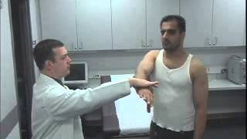
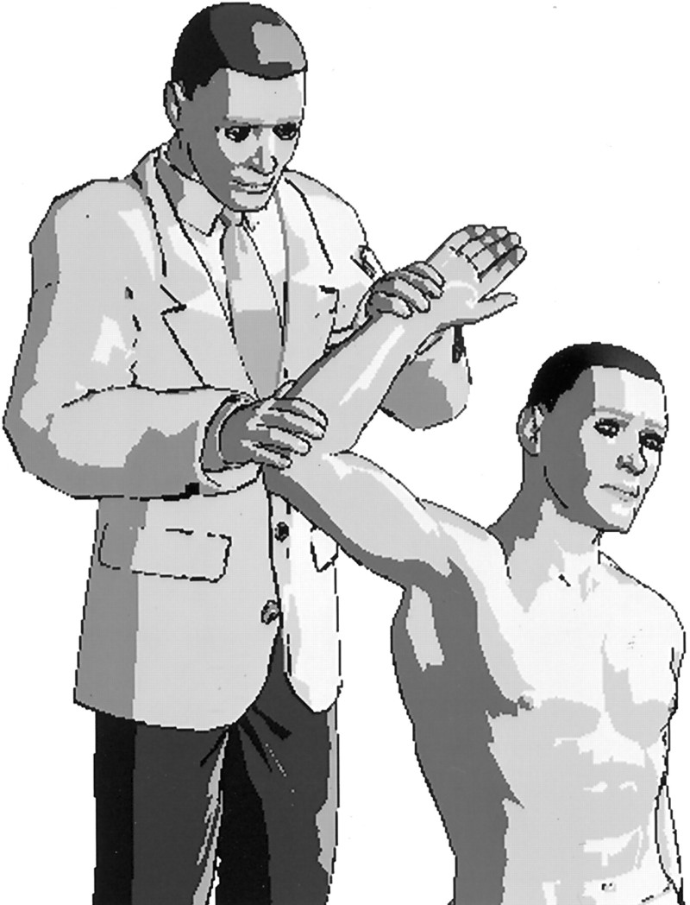
Special Tests
Labrum
O’Brien’s
Crank test
SLAPprehension
Notes:
Speeds and yergason’s can also be positive
– obrien

Slide 18
Specific Examples
Rotator Cuff Pathology
“Frozen Shoulder”
Shoulder Instability
AC Joint Separation
Arthritis
Labral Tear
“SICK Scapula”
Main points:
Presenting symptoms
PE findings
Diagnosis
Conservative treatment or refer?
Notes:
Speeds and yergason’s can also be positive
https://www.youtube.com/watch?v=3G6mb1QQ90I – obrien
https://www.youtube.com/watch?v=JQI_om7b_JM - crank
http://ameblo.jp/g-money0229/entry-11512342937.html - crank

Slide 19
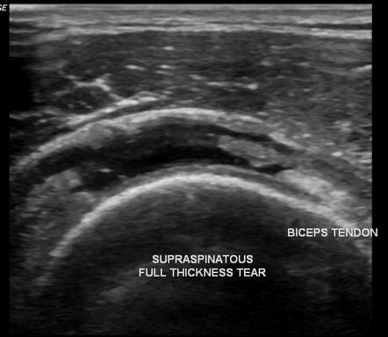
Rotator Cuff Pathology
Diagnosis:
Xray – often negative
Ultrasound
Consider MRI if planning for surgery
Management:
Tendinopathy or impingement – conservative treatment, PT, subacromial GC injection
Partial-thickness tear – PT (up to 12 weeks), possibly subacromial GC injection
Full-thickness tear – Ortho referral
Notes:
MRI – if planning surgery
Xray – may show superior migration of humeral head with large cuff tear, if need to r/o fracture; could show type 2 of 3 acromion which predisposes
Conservative treatment – avoid agg factors, NSAIDs, ice
Tendinopathy – if PT fails, consider subacromial injection
Full thickness tear:
If healthy, surgery in 3-6 weeks
If elderly, comorbidities, non-compliant, then likely nonoperative treatment

Slide 20
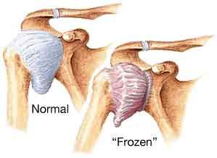
“Frozen Shoulder” (Adhesive Capsulitis)
Presentation & symptoms:
Pain, often >3 months
Progressive loss of ROM
Age >40yo
Risk factors: immobility, DM, hypothyroidism
Physical exam findings:
Limited active ROM, external rotation often 50% normal
Endpoint with passive ROM
Notes:
Contraction of GH joint capsule and adherence to the humeral head
Pain with ROM

Slide 21
“Frozen Shoulder” (Adhesive Capsulitis)
Diagnosis:
CLINICAL!
Xray if need to rule-out fracture or OA
US later if concerned for RC pathology
Management:
Set expectations
Pain control, gentle ROM exercises/PT
If severe, intra-articular GC injection under fluoroscopy
Notes:
Expectations: risk to c/l side, 90% recover in 12-18 months
May never fully resolve
Add lidocaine or saline to injection, sometime prior to PT if severe enough
Or subacromial injection

Slide 22
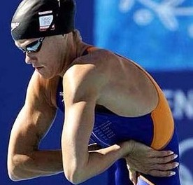
Shoulder (GH) Instability
Presentation & symptoms:
Pain
Instability
Age < 40yo
Transient neurologic symptoms
History of dislocation or subluxation
Physical exam findings:
+ sulcus
+ apprehension & relocation
+ load & shift testing
Notes:
Pain – often anterolateral
Transient neuro syxs – weakness, tingling, numbness
Trauma or overhead sport
Not laxity! Instabilty may have laxity, but laxity is asxic…

Slide 23
Shoulder (GH) Instability
Diagnosis:
Clinical
Xrays often normal
MR arthrogram if no improvement
Management:
Activity modification
PT focused on aggressive strengthening
Refer to Ortho if no improvement with PT or if recurrent dislocation
Notes:
Xray could show Hill Sach’s lesion – indentation of posterior aspect of humeral head when should dislocates anteriorly and back of humeral head contacts anterior edge of glenoid OR may see avulsion fracture
MR if no improvement or concern for labrum
Activity modification – no overhead, bench press, etc

Slide 24
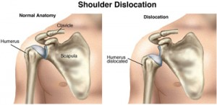
Acute Shoulder Dislocation
Physical Exam:
External rotation & abduction, palpable humeral head
Check innervation of skin over lateral deltoid! (Axillary nerve)
Diagnosis:
Clinical
Xray
Management:
Relocate & immobilize
ROM exercises within 7-10 days → aggressive rehab program
Notes:
Xray could show Hill Sach’s lesion – indentation of posterior aspect of humeral head when should dislocates anteriorly and back of humeral head contacts anterior edge of glenoid OR may see avulsion fracture
Activity modification – no overhead, bench press, etc

Slide 25
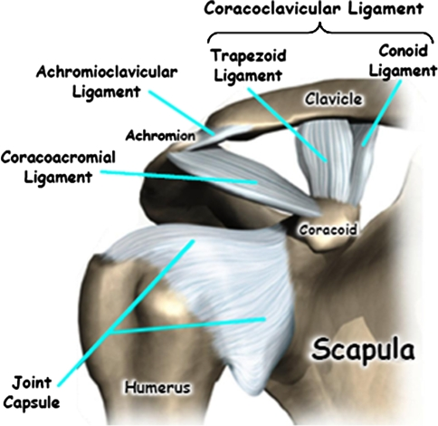
AC Joint Separation
Presentation & symptoms:
Direct blow to shoulder or FOOSH
Male contact sport athlete, ~20yo
Pain/swelling
Physical exam findings:
Pain and swelling over AC joint
“Stepped” deformity if more severe
+ cross-arm test
+ painful arc
Notes:
Stepped deformity b/t acromion and clavicle

Slide 26
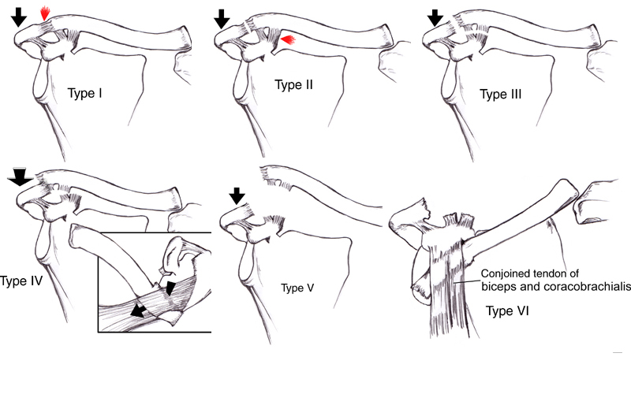
AC Joint Separation
Diagnosis:
Clinical +
Xray
Management:
Types I-III: Non-operative (rest, ice, analgesics, sling for immobilization, PT)
Types IV+: Ortho referral for surgery
Notes:
Xray – single AP with both joints or 2 AP views
Zanca view –allows AC to be seen without overlapping bone; AP with 10-15 degree cephalic tilt)
Types i-iii – 2 to 12 weeks

Slide 27
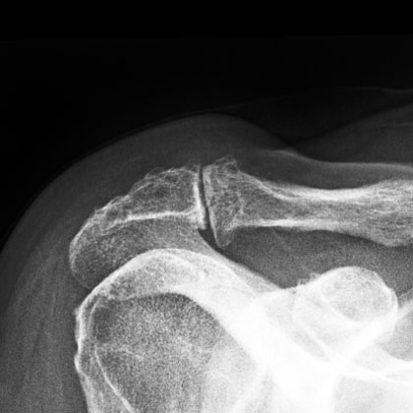
Shoulder Arthritis
Presentation & symptoms:
Age >50
Progressive pain with activity
Decreased ROM
Impingement symptoms
History of rotator cuff injury, previous trauma, or shoulder surgery
Physical exam findings:
AC joint: tenderness over AC joint, pain at extreme internal rotation, + cross-arm test
GH joint: decreased ROM, pain and crepitus at extremes of motion
Notes:
Impingement sxs with AC joint arthritis

Slide 28
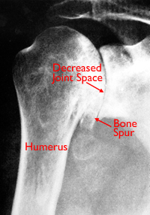
Shoulder Arthritis
Diagnosis:
Clinical +
Xray
Management:
AC joint:
Activity modification, NSAIDs, GC injection
GH joint:
Goal = maintain function with adequate pain control
PT, glucosamine & chondroitin, intra-articular GC injection
Referral to Ortho if conservative treatment fails
Notes:
Xrays – typical are AP, scapular Y, and axillary, and stryker notch (4 view); loss of joint space, osteophyte
Activity modification – overhead activities; golf for AC joint

Slide 29
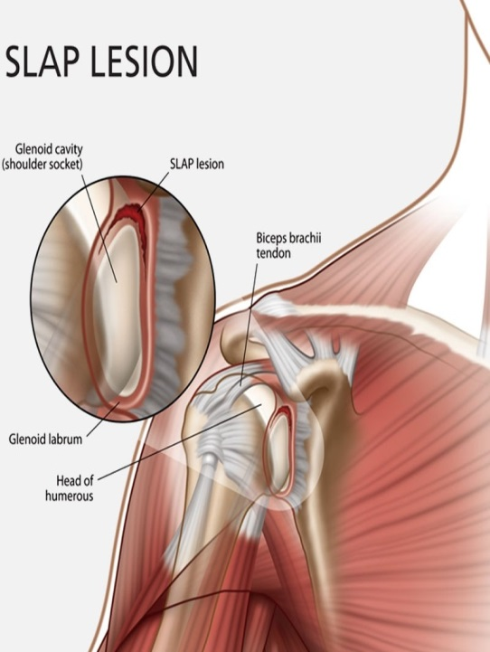
Labral Tear
Presentation & Symptoms:
Pain +/- instability
Clicking/popping
Overhead athlete, history of dislocation, history of trauma
Physical Exam:
Pain with passive external rotation
Pain with palpation of bicipital groove
Notes:
Click/pop with movement
Physical exam: can have positive biceps tests!
Superior labrum anterior posterior = SLAP & Bankart lesion (lower) – associated with dislocation
-pain where biceps tendon anchors to the labrum
- Concomitant RC injury also common

Slide 30
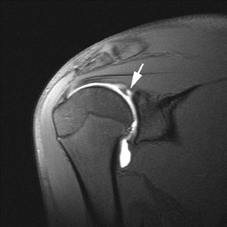
Labral Tear
Diagnosis:
Xrays usually normal but may show Hills-Sach lesion
MRI or MR arthrogram
Management:
Conservative: rest, NSAIDs → PT
Operative: Ortho referral
If conservative measures fail, larger tears, concomitant RC tear
Notes:
Slap tear
MRI – better for anterior tears

Slide 31
Shoulder Summary
History | Physical | Diagnosis
<25, new Activity, Trauma, Overhead Sports, Acute or Chronic | + Apprehension | Shoulder Instability
25-40, gradual onset, pain overhead activity | + Empty Can + Neer | Stage I Impingement (Supraspinatous Tendonopathy)
>40, gradual onset, pain overhead activity, night pain | + Empty Can + Neer + Hawkins | Stage II/III Impingement (partial/complete rotator cuff tear)
Gradual onset painful stiff shoulder. Often no h/o trauma | + Decrease active and passive ROM +Neer | Adhesive Capsulitis
Repetitive motion, new lifting regimen, OA | + Speed + Yergason | Biceps Tendonitis (if Popeye, Biceps Tendon Rupture)

