Slide 1
Rhematoid arthritis
Dr Saremi. BUMS, Associated professor of rheumatology
@drzsaremi
www.drzeinabsaremi.ir

Slide 2
Clinical manifestation

Slide 11
Articular manifestation
ν
ν
ν
Pain in affected
joint aggravated by
movemnt is the
most common
symptom.
Morning stiffness
≥1 hr
Joints involved -◊

Slide 12
Relative incidence of joint
involvement in RA
ν
ν
ν
ν
ν
MCP and PIP joints of hands & MTP of feet
Knees, ankles & wrists-
Shoulders-
Elbows-
TM, Acromio - clavicular & SC joints-
90%
80%
60%
50%
30%

Slide 13
Joints involved in RA
ν
ν
Don’t forget the cervical spine!!
Instability at cervical spine can lead to
impingement of the spinal cord.
Thoracolumbar, sacroiliac, and distal
interphalangeal joints (DIP)of the hand are
NOT involved.

Slide 14
PIP Swelling

Slide 15
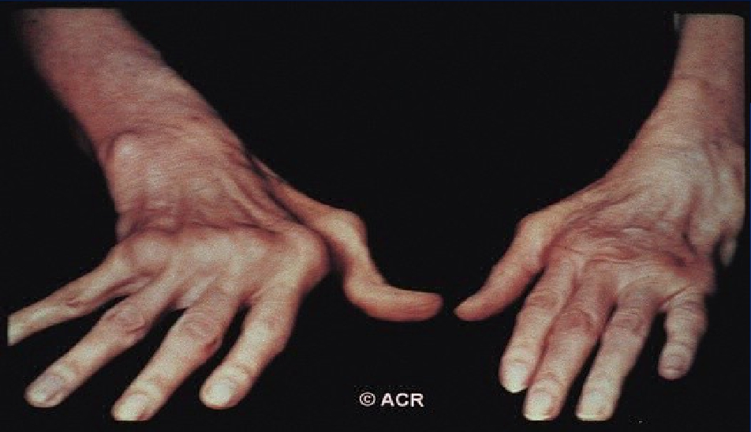
Ulnar Deviation, MCP Swelling,
Left Wrist Swelling

Slide 16
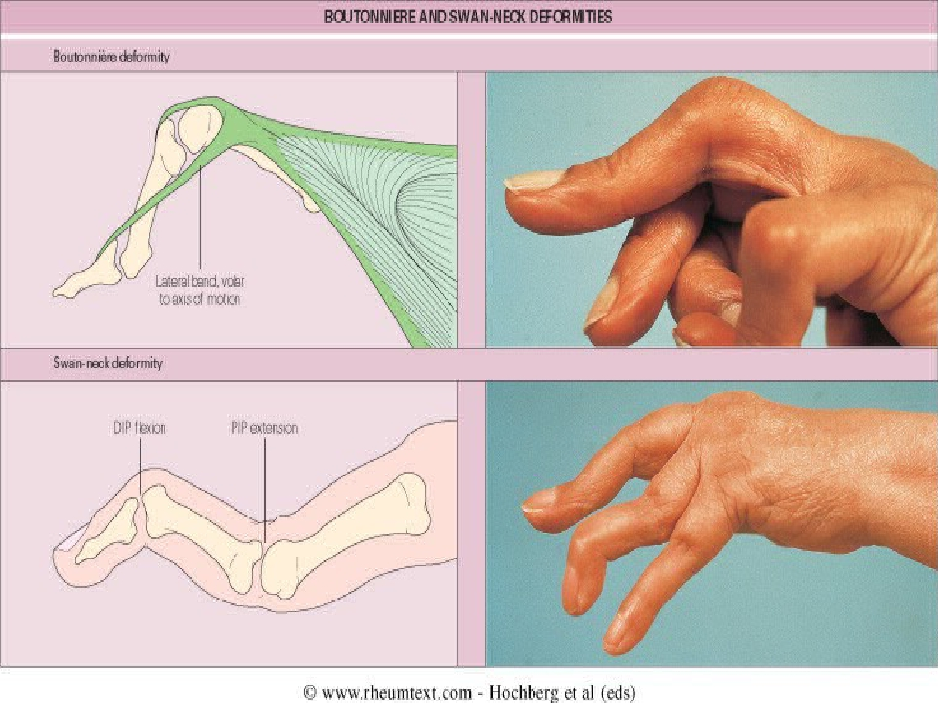

Slide 17
Z deformity

Slide 18
Extra-articular manifestation
Present in
May occur prior to arthritis
Patients that are more likely to get are:
ν
ν
ν
30-40%
ν
ν
ν
ν
ν
High titres of RF/ anti-CCP
HLA DR4+
Male
Early onset disability
History of smoking

Slide 19
Extraarticular Involvement
ν
ν
ν
Constitutional symptoms ( most common)
Rheumatoid nodules(30%)
Hematological-
ν
ν
ν
normocytic normochromic anemia
leucocytosis /leucopenia
thrombocytosis
ν
Felty’s syndrome-
ν
Chronic nodular Rheumatoid Arthritis
ν Spleenomegaly
ν Neutropenia

Slide 20
ν
ν
ν
ν
ν
Respiratory- pleural effusion, pneumonitis ,
pleuro-pulmonary nodules, ILD
CVS-asymptomatic pericarditis , pericardial
effusion, cardiomyopathy
Rheumatoid vasculitis- mononeuritis multiplex,
cutaneous ulceration, digital gangrene, visceral
infarction
CNS- peripheral neuropathy, cord-compression
from atlantoaxial/midcervical spine subluxation,
entrapment neuropathies
EYE- kerato cunjunctivitis sicca, episcleritis,
scleritis

Slide 21
Rheumatoid nodule

Slide 23
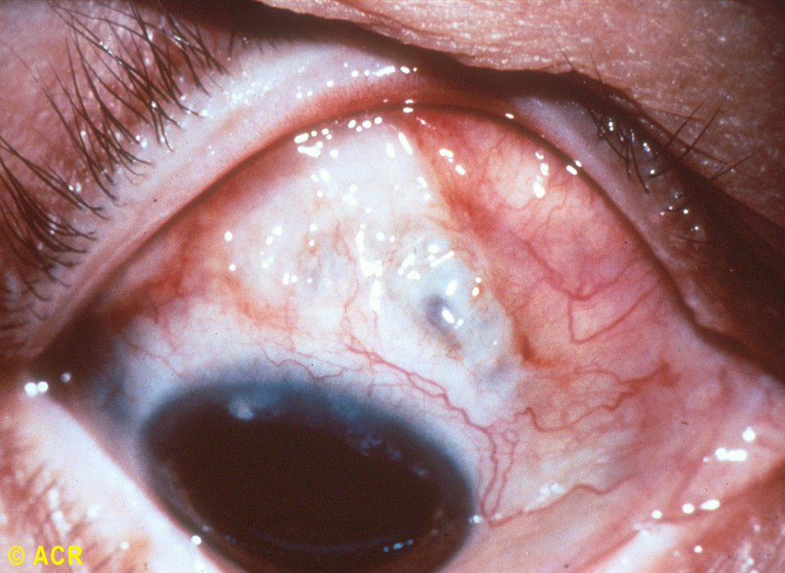

Slide 28
Arthritogenic Antigen
Exogenous
EBV Mycoplasma
Hepatitis MycoBacterium
Paro Virus B19 Yarsenia
Streptococcus
Endogenous
Citrullinated Peptide
viral
Bacterial

Slide 29
genetic
HLA class II is strongly linked to RA.
HLA DR4 is the major halo-type in ethnic group, HLA DR1 in Indians and HLA DW15 in Japanese.

Slide 30
Laboratory investigations in RA
ν
ν
ν
ν
CBC- TLC, DLC, Hb, ESR & GBP
Acute phase reactants
Rheumatoid Factor (RF)
Anti- CCP antibodies

Slide 31
Rheumatoid Factor (RF)
ν
ν
ν
•
•
Antibodies that recognize Fc portion of IgG
Can be IgM , IgG , IgA
85% of patients with RA over the first 2 years become RF+
A negative RF may be repeated 4-6 monthly for the first two year of
disease, since some patients may take 18-24 months to become
seropositive.
PROGNISTIC VALUE- Patients with high titres of RF, in general,
tend to have POOR PROGNOSIS, MORE EXTRA ARTICULAR
MANIFESTATION.

Slide 32
Causes of positive test for RF
ν
ν
ν
ν
ν
ν
ν
ν
ν
ν
Rheumatoid arthritis
Sjogrens syndrome
Vasculitis such as polyarteritis nodosa
Sarcoidosis
Systemic lupus erythematosus
Cryoglobulinemia
Chronic liver disease
Infections- tuberculosis , bacterial endocarditis, infectious
mononucleosis, leprosy, syphilis, leishmaniasis.
Malignancies
Old age(5% women aged above 60)

Slide 33
Anti-CCP
ν
ν
ν
ν
IgG against synovial membrane peptides
damaged via inflammation
Sensitivity (65%) & Specificity (95%)
Both diagnostic & prognostic value
Predictive of Erosive Disease
ν
Disease severity
ν Radiologic progression
ν Poor functional outcomes

Slide 34
ν
Elevated APRs( ESR, CRP )
ν Thrombocytosis
ν Leukocytosis
ν ANA
ν30-40%
ν
Inflammatory synovial fluid
ν Hypoalbuminemia

Slide 35
Radiographic Features
ν
ν
ν
ν
ν
ν
ν
ν
Peri-articular osteopenia
Uniform symmetric joint space narrowing
Marginal subchondral erosions
Joint Subluxations
Joint destruction
Collapse
Ultrasound detects early soft tissue lesions.
MRI has greatest sensitivity to detect
synovitis and marrow changes.

Slide 38
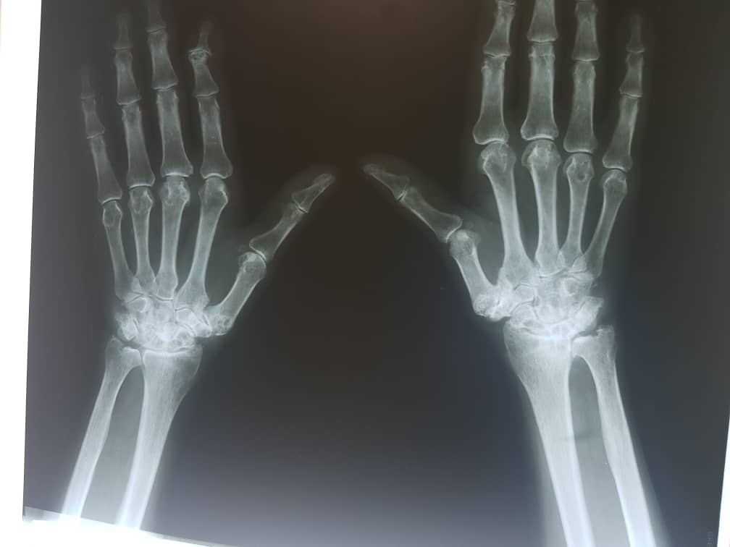

Slide 41
2010 ACR/EULAR Classification Criteria
a score of ≥6/10 is needed for classification of a patient as having definite RA
A. Joint involvement SCORE
1 large joint 0
2−10 large joints 1 1−3 small joints (with or without involvement of large joints) 2
4−10 small joints (with or without involvement of large joints) 3
>10 joints (at least 1 small joint)†† 5
B. Serology (at least 1 test result is needed for classification)
Negative RF and negative ACPA 0
Low-positive RF or low-positive ACPA 2
High-positive RF or high-positive ACP 3
C. Acute-phase reactants (at least 1 test result is needed for classification)
Normal CRP and normal ESR 0
Abnormal CRP or normal ESR 1
D. Duration of symptoms
<6 weeks 0
≥6 weeks 1

Slide 42
treatment

Slide 43
Goals of management
ν
ν
ν
ν
ν
ν
ν
Focused on relieving pain
Preventing damage/disability
Patient education about the disease
Physical Therapy for stretching and range of motion
exercises
Occupational Therapy for splints and adaptive
devices
Treatment should be started early and should be
individualised .
EARLY AGGRESSIVE TREATEMNT

Slide 44
Treatment modalities for RA
ν
ν
ν
ν
ν
ν
NSAIDS
Steroids
DMARDs
Immunosuppressive therapy
Biological therapies
Surgery

Slide 45
NSAIDS
Non-Steroidal anti-inflammatories
(NSAIDS) / Coxibs for symptom control
1)
2)
3)
4)
Reduce pain and swelling by inhibiting COX
Do not alter course of the disease.
Chronic use should be minimised.
Most common side effect related to GI tract.

Slide 46
Corticosteroids in RA
ν
ν
Corticosteroids , both systemic and intra-articular are
important adjuncts in management of RA.
Indications for systemic steroids are:-
1.
2.
3.
4.
5.
For treatment of rheumatoid flares.
For extra-articular RA like rheumatoid vasculitis and
interstitial lung disease.
As bridge therapy for 6-8 weeks before the action of
DMARDs begin.
Maintainence dose of 10mg or less of predinisolone daily
in patients with active RA.
Sometimes in pregnancy when other DMARDs cannot be
used.

Slide 47
Disease Modifying Anti-rheumatic Agents
ν
ν
ν
ν
ν
Drugs that actually alter the disease course .
Should be used as soon as diagnosis is made.
Appearance of benefit delayed for weeks to
months.
NSAIDS must be continued with them until true
remission is achieved .
Induction of true remission is unusual .

Slide 48
DMARDs
Commonly used
Methotrexate
Hydroxychloroquine
Sulphasalazine
Leflunomide
Less commonly used
Chloroquine
Gold(parenteral &oral)
CyclosporineA
D-penicillamine/bucillamine
Minocycline/Doxycycline
Levamisole
Azathioprine,cyclophosphamide,
chlorambucil

Slide 49
Immunosuppresive therapy
Agent
Azathioprine
Usual dose/route
50-150 mg orally
Side effects
GI side effects ,
myelosuppression, infection,
.
3-5 mg/kg/day
50 -150 mg orally
.
Cyclosporin A
Cyclophosphamide
Nephrotoxic , hypertension ,
hyperkalemia
Myelosuppression , gonadal
toxicity ,hemorrhagic cystitis ,
bladder cancer

Slide 50
Biologic drugs
TNF inhibitors( infliximab- adalimumab- etanercept)
Anti CD20( rituximab)
Anti IL 6

