Slide 1
Dr Saremi. BUMS, Assistant professor of rheumatology
@drzsaremi
www.drzeinabsaremi.ir

Slide 2
Gout is a metabolic disease that most often affects middle-aged to elderly men and postmenopausal women.
Woman 5- 20% of all patients
It results from an increased body pool of urate with hyperuricemia.
It typically is characterized by:
episodic acute arthritis or chronic arthritis
nephrolithiasis

Slide 4
MSK symptoms
Acute arthritis
Chronic non symmetric synovitis
periarticular tophaceous deposits in the absence of synovitis
Bursitis
Tendinitis
CTS
OA
Spinal arthritis

Slide 7
Several events may precipitate acute gouty arthritis:
dietary excess,
trauma,
surgery,
excessive ethanol ingestion,
hypouricemic therapy,
serious medical illnesses such as myocardial infarction and stroke.

Slide 9
diagnosis
diagnosis ideally should be confirmed by needle aspiration of acutely or chronically involved joints or tophaceous deposits.
Synovial fluid leukocyte counts are elevated from 2000 to 60,000/μL.
Effusions appear cloudy due to the increased numbers of leukocyte
Intra and extra cellular MSU

Slide 10
Lab data
Serum uric acid
24-h urine collection for uric acid . Excretion of >800 mg of uric acid per 24 h on a regular diet suggests that causes of overproduction of purine should be considered.

Slide 11
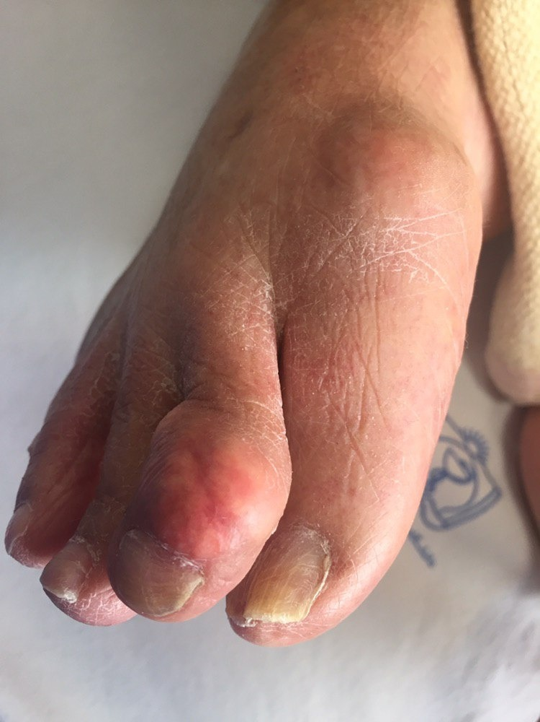
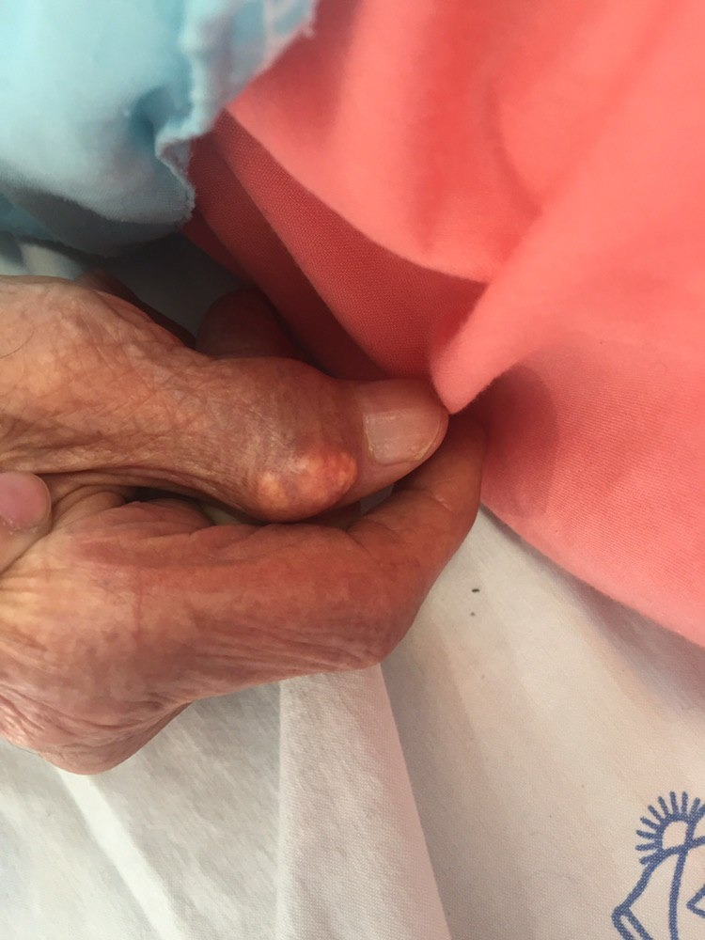

Slide 12
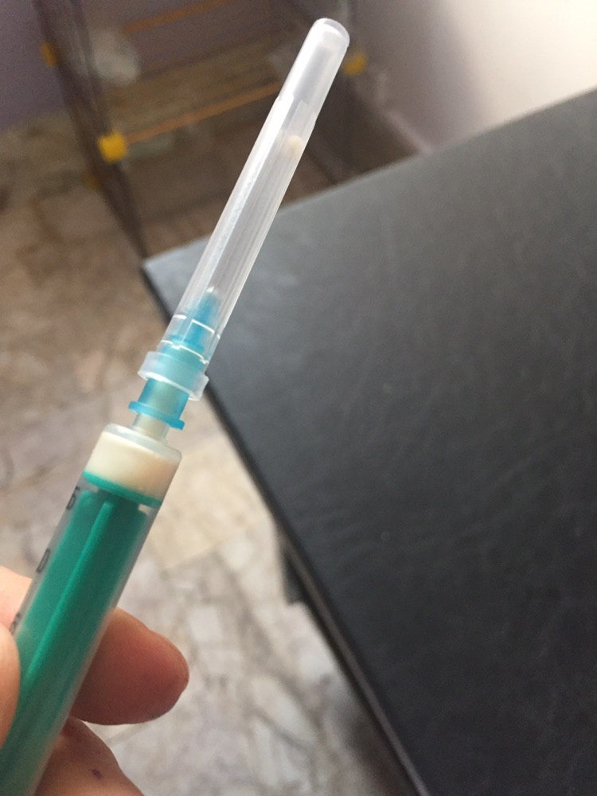

Slide 13
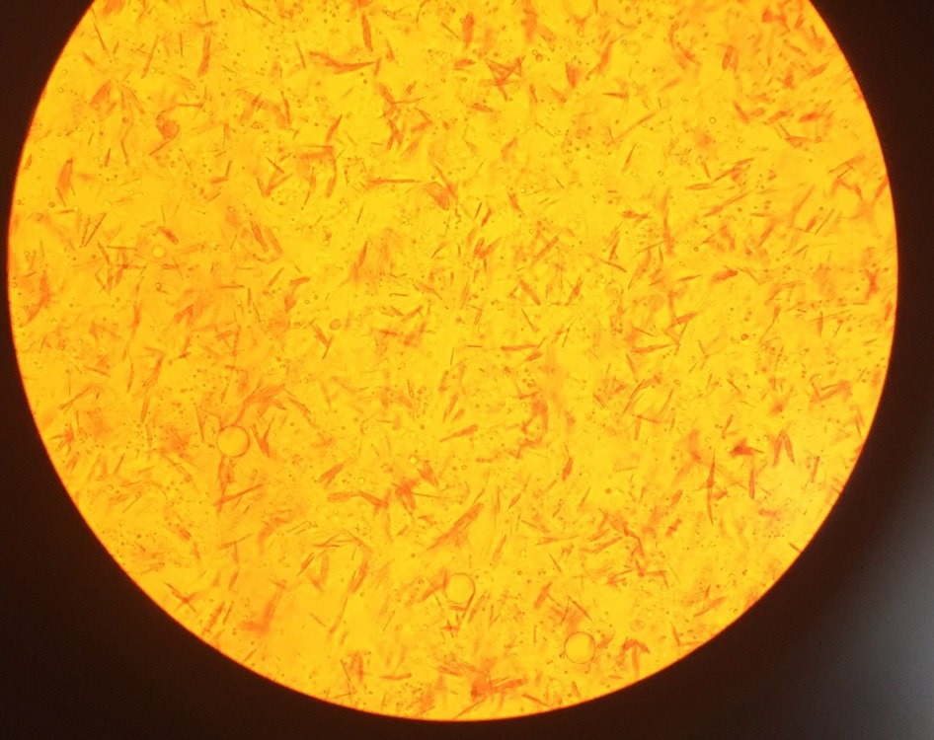

Slide 17
Radiography
Cystic changes,
well-defined erosions with sclerotic margins (often with overhanging bony edges),
and soft tissue masses
are characteristic radiographic features of advanced chronic tophaceous gout

Slide 21
treatment
Acute gouty artritis:
NSAIDs
Glucocirticoids
colchicine

Slide 22
Hypouricemic therapy:
( aim: serum uric acid: 5-6 mg/dl)
xanthine oxidase inhibitor: allopurinol, febuxostat
uricosuric agent: probencid
Pegloticase
diet:

Slide 23
Urate-lowering drugs are generally not initiated during acute attacks

Slide 24
CPPD
CALCIUM PYROPHOSPHATE DEPOSITION DISEASE

Slide 25
ATP ADP+ PPi
Ppi CPP crystal
هر عاملی که با افزایش سطح پیروفسفات خارج سلولی همراه باشد منجر به تشکیل کریستالهای پیروفسفات میشود

Slide 26
The deposition of CPP crystals in articular tissues is most common in the elderly,
occurring in 10–15% of persons age 65–75 years and 30–50% of those >85 years.

Slide 27
It is likely that biochemical changes in aging or diseased cartilage favor crystal nucleation

Slide 28
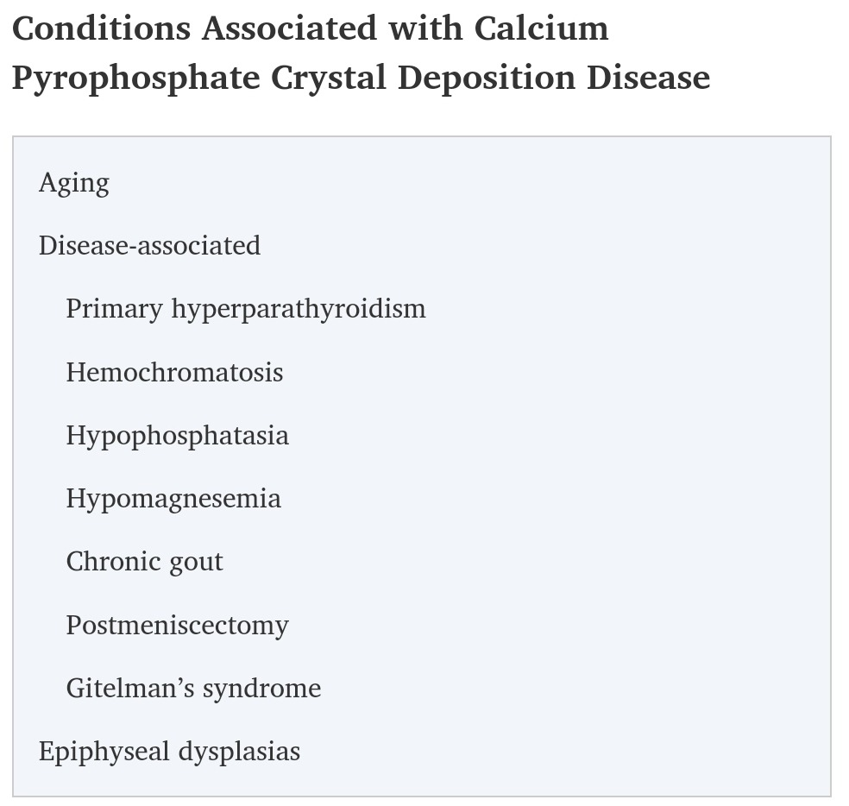

Slide 29
Clinical manifestation
(1) association with or enhancement of peculiar forms of OA
(2) induction of severe destructive disease that may radiographically mimic neuropathic arthritis;
(3) production of chronic symmetric synovitis that is clinically similar to RA
(4) pseudo gout

Slide 30
(5) rarely periarticular tophus-like nodules.
(6) FUO
(7) recurrent hemarthrosis
(8) intervertebral disk and ligament calcification with restriction of spine mobility, the crowned dens syndrome, or spinal stenosis (most commonly seen in the elderly

Slide 31
Knee is most frequent
Wrist, shoulder, ankle, elbow, hand AND TMJ
Poly articular in 2/3

Slide 35
The leukocyte count in synovial fluid in acute CPPD can range from several thousand cells to 100,000 cells/μL, with the mean being about 24,000 cells/μL and the predominant cell being the neutrophil.

Slide 37
TREATMENT
NSAID
Intraarticular injection
Colchicine
GC
MTX
HCQ

