Slide 1
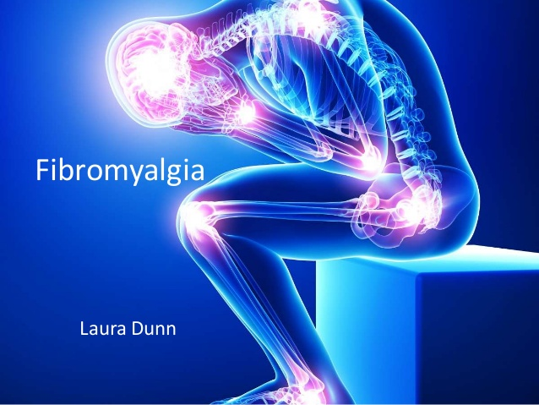
Fibromyalgia
Dr Saremi. BUMS, Associated professor of rheumatology
@drzsaremi
www.drzeinabsaremi.ir

Slide 2
chronic widespread musculoskeletal pain and tenderness.
associated neuro-psychological symptoms:
fatigue,
unrefreshing sleep,
cognitive dysfunction,
anxiety,
depression.

Slide 3
Patients with FM have an increased prevalence of other syndromes associated with pain and fatigue:
chronic fatigue syndrome
temporomandibular disorder,
chronic headaches,
IBS
interstitial cystitis/painful bladder syndrome,
and other pelvic pain syndromes.

Slide 4
Epidemiology
2%- 5%
F/M: 2-9/1

Slide 6
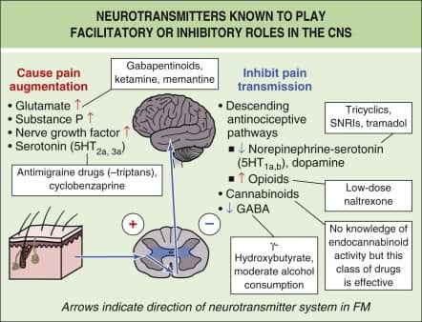

Slide 7
Clinical manifestation
1- Pain and tenderness:
Pain all over
above and below the waist
on both sides of the body
involves the axial skeleton (neck, back, or chest).

Slide 8
The pain attributable to FM is poorly localized,
difficult to ignore,
severe in its intensity,
associated with a reduced functional capacity.

Slide 9
For a diagnosis of FM, pain should have been present most of the day on most days for at least 3 months.

Slide 11
classification criteria of the ACR 1990 required that 11 of 18 sites be perceived as painful for a diagnosis of FM.

Slide 12
classification criteria ACR 2010

Slide 14
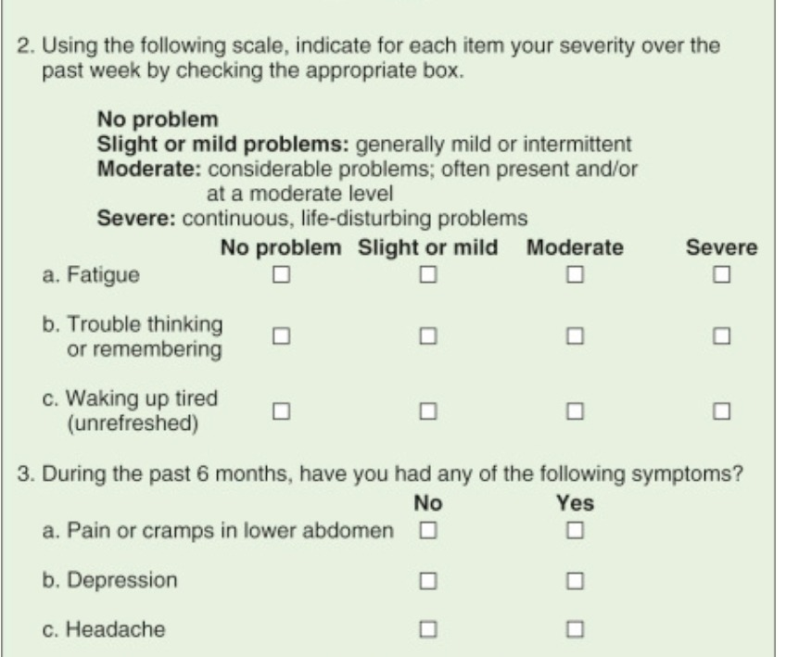

Slide 15
Newer criteria:
eliminate the need for identification of tender points
focus instead on clinical symptoms of widespread or multi-site pain and neuropsychological symptoms.

Slide 16
Comorbid condition
it occurs in ≥20% of patients with degenerative or inflammatory rheumatic disorders, metabolic and infection

Slide 17
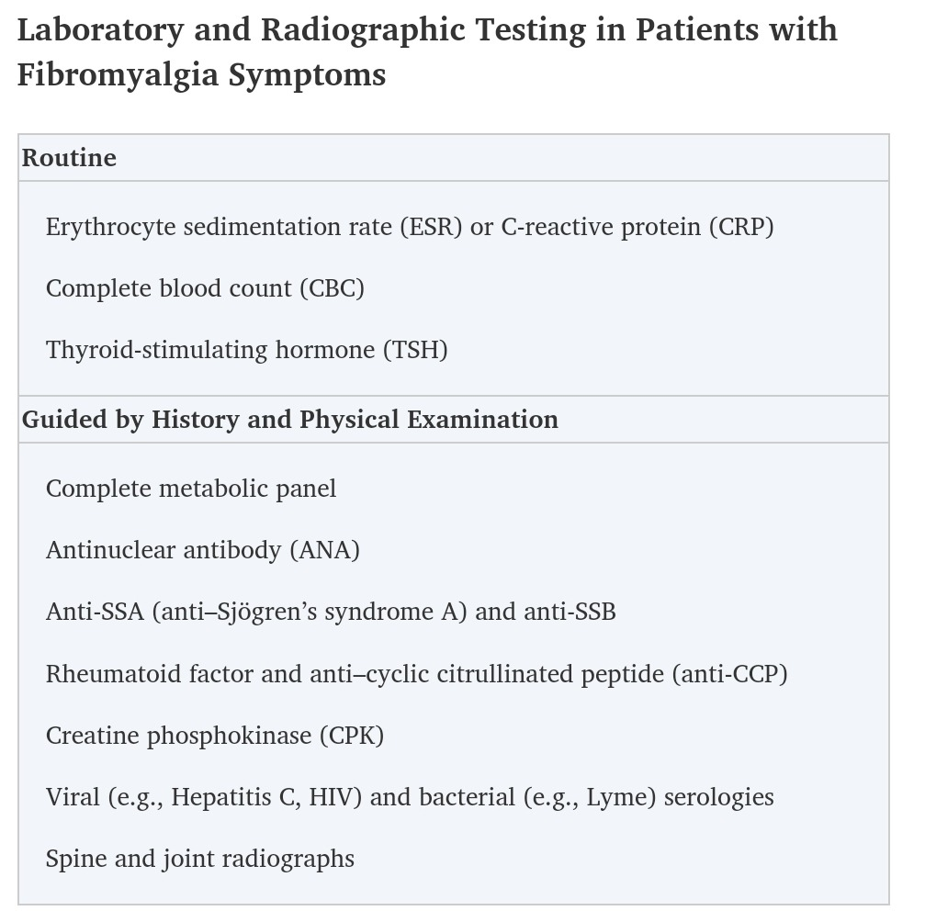

Slide 18
Differential diagnosis
Inflammatory: PMR- RA- SLE- SPA- SS
Infections: EBV- HCV- HIV- B19
Endocrine
Neurologic disease:
Psychiatric inhibitors
Drugs: statin- aromatase inhibitors
Non inflammatory: Degenerative joint/spine/disk disease- Myofascial pain syndromes- Bursitis, tendinitis, repetitive strain injuries

Slide 19
treatment
Non pharmacologic
Pharmacologic:
Muscle relaxant: Cyclobenzaprine
Antidepressants Amitryptiline- Duloxetine- Milnacipran-
Anticonvulsants: Pregabalinb
Analgesic

