Slide 1
Dupuytren contracture trigger finger

Slide 2
Dupuytren contracture
Common
Progressive fibrosis of palmar fascia
Loss of extension
Formation of a nodule or nodules occurs in the early proliferative stage of the disease and is the pathognomonic lesion of Dupuytren's contracture.

Slide 3
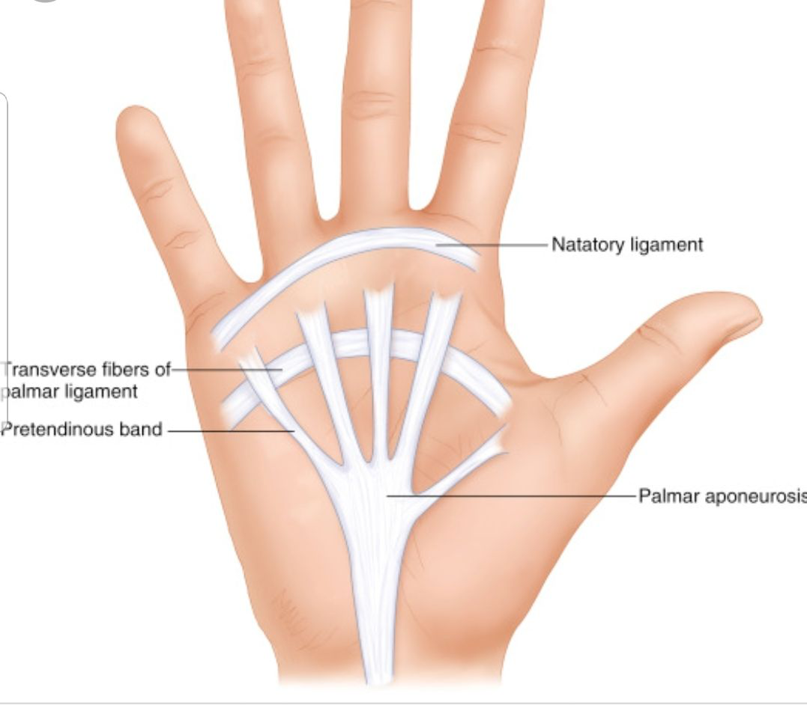

Slide 4
Etiology:
genetic-
ethnicity-
age- >50
Enviromental: repetitive handling tasks or vibration
alchol-
DM- 16-42%
smoking
association of Dupuytren's contracture with epilepsy and with the use of anticonvulsants has been proposed

Slide 5
80% Men
First symptome is nodule
Rub of palm
Ulnar side- The third finger is less often affected, and the index finger and thumb are typically spared.

Slide 6
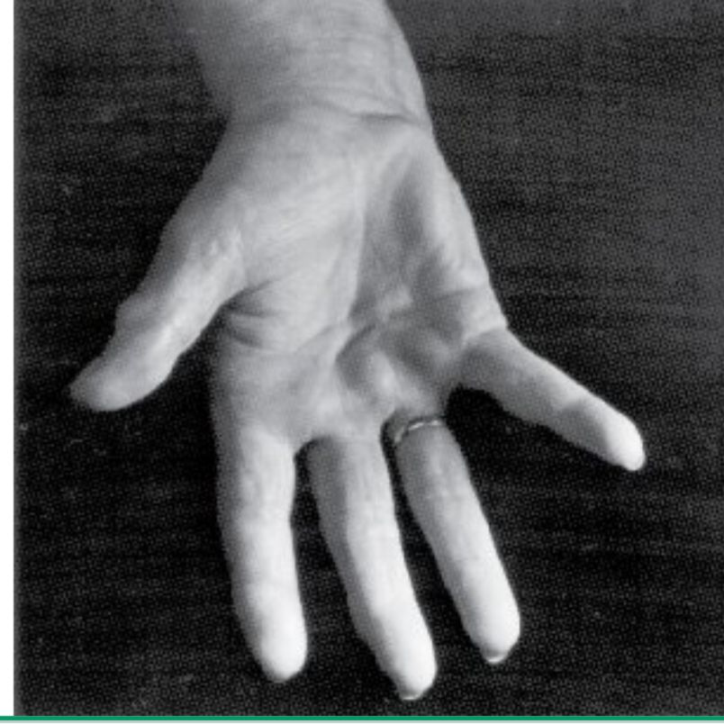

Slide 7
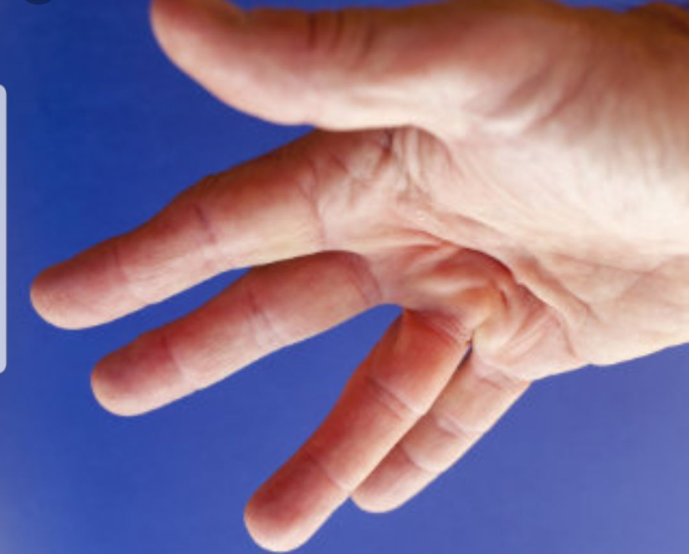
triangular "puckering

Slide 8
plantar fibrosis, knuckle pads, and radial side involvement have a stronger influence on recurrence and extension of Dupuytren's
Signs of inflammation are absent in most cases; local tenderness, swelling, and pain with passive flexion and extension are absent

Slide 9
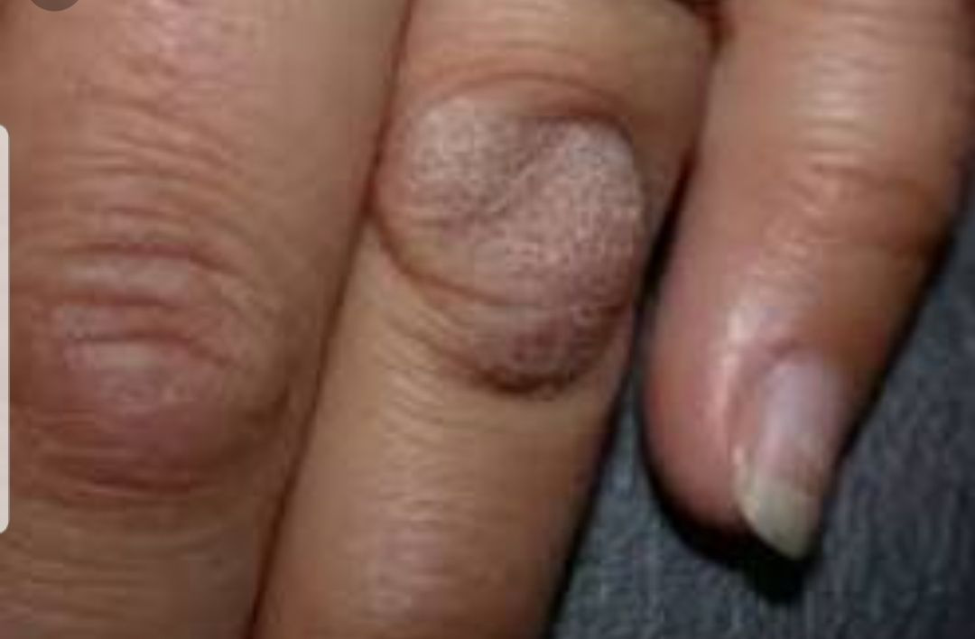

Slide 10
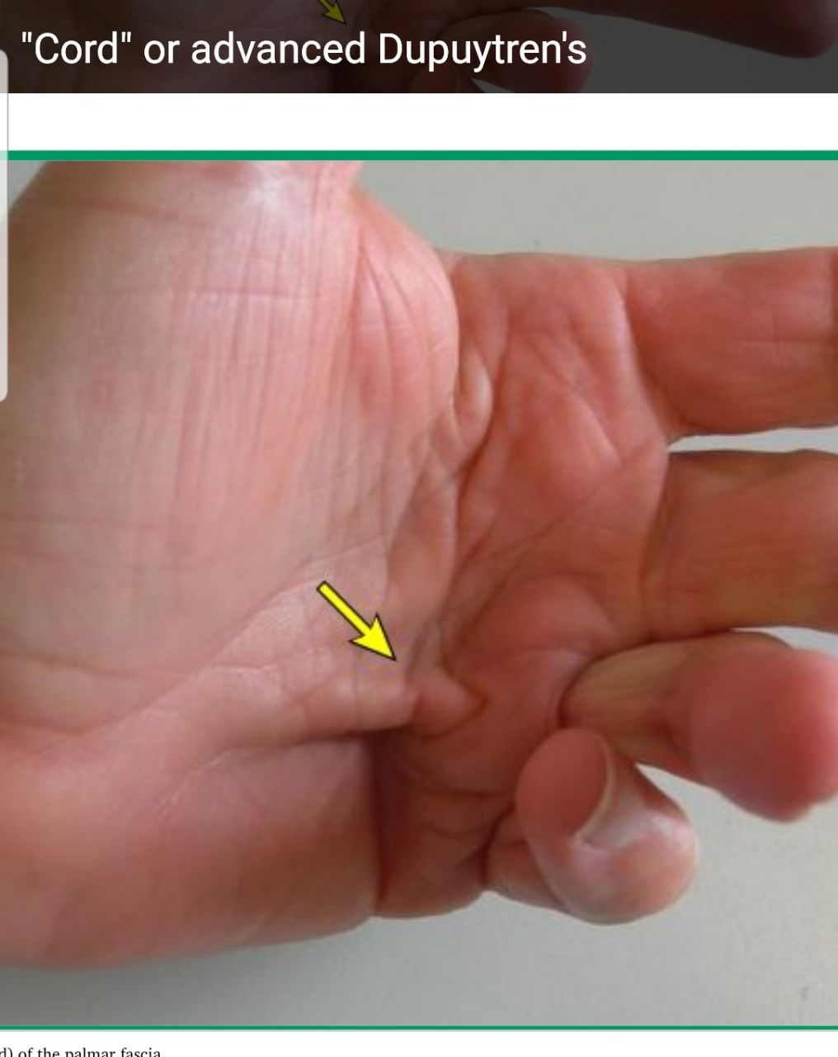

Slide 11
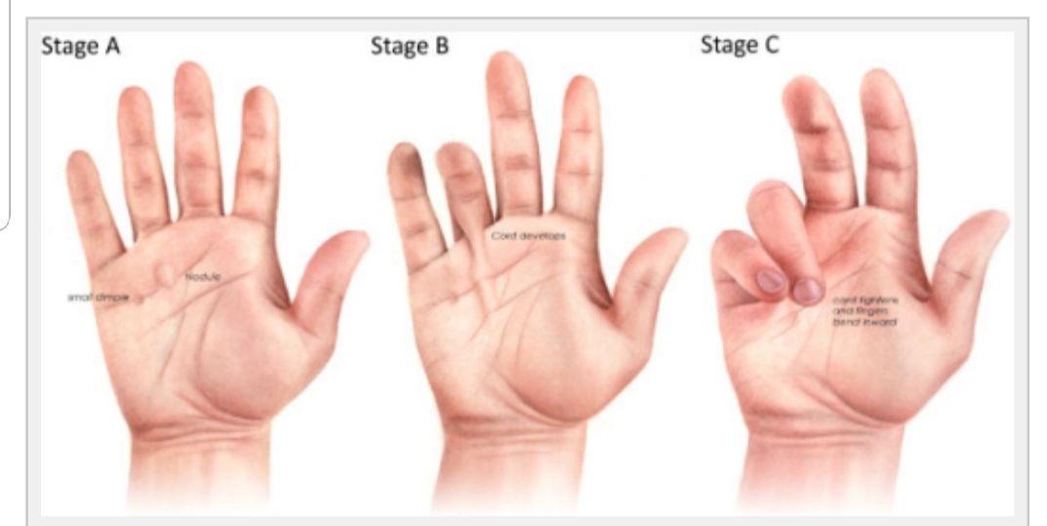

Slide 12
DDX
Non-Dupuytren’s palmar fascial disease’’ as a non-progressive palmar fascial proliferation
Diabetic cheiroarthropathy (limited joint mobility),
palmar fibromatosis (also referred to as palmar fasciitis),
camptodactyly,
traumatic scars,
Volkmann's ischemic contracture,
intrinsic joint disease.

Slide 13
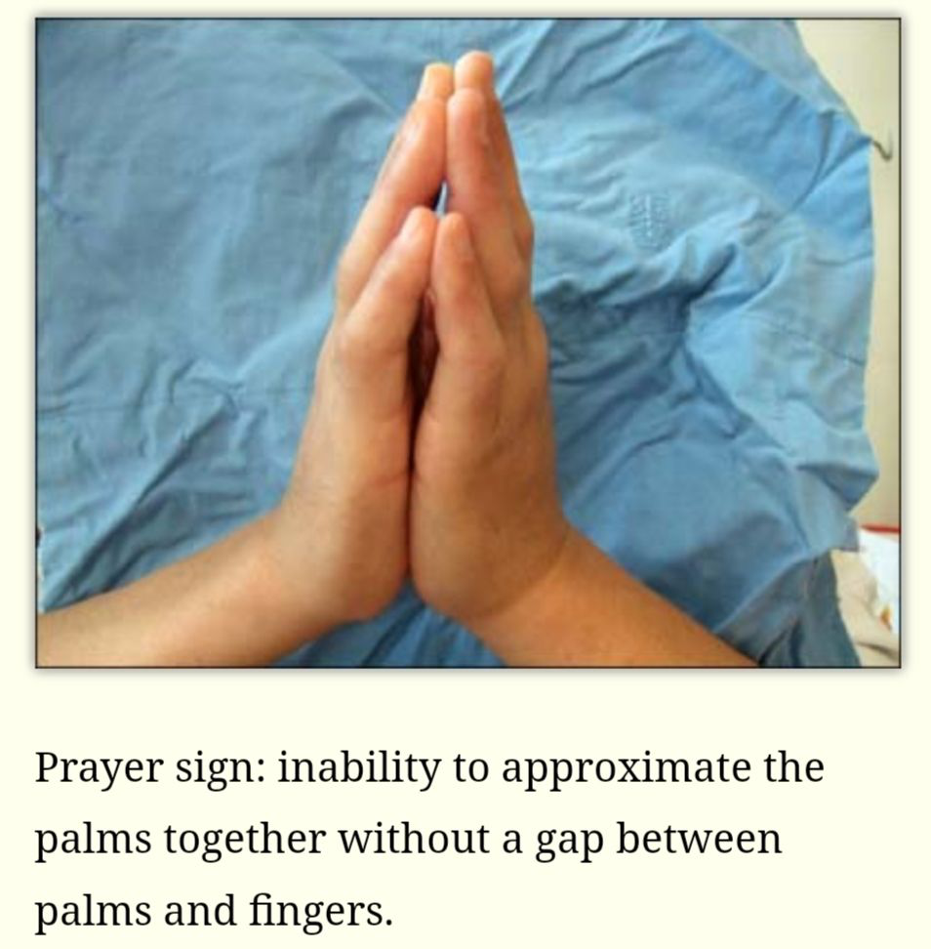

Slide 14
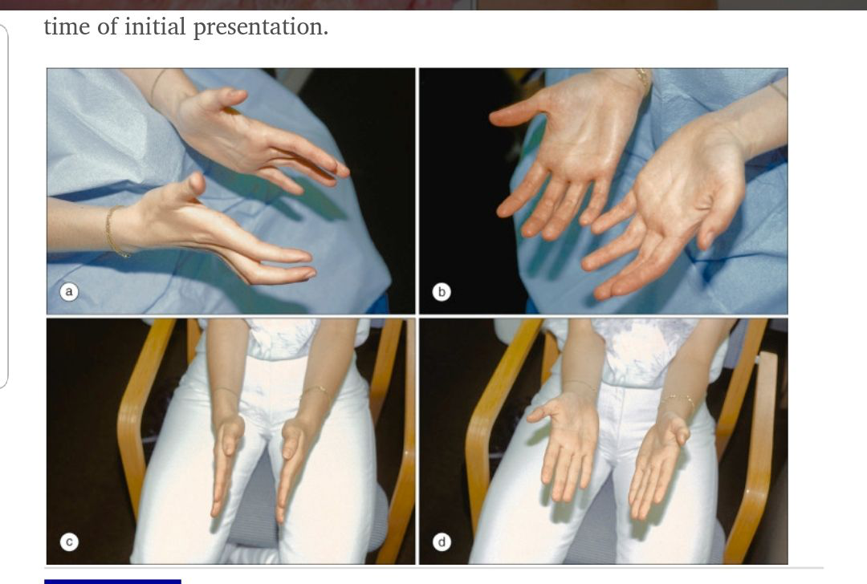

Slide 15
The palmar nodular fasciitis resembles Dupuytren contracture but is in contrast much more severe and inflammatory

Slide 16
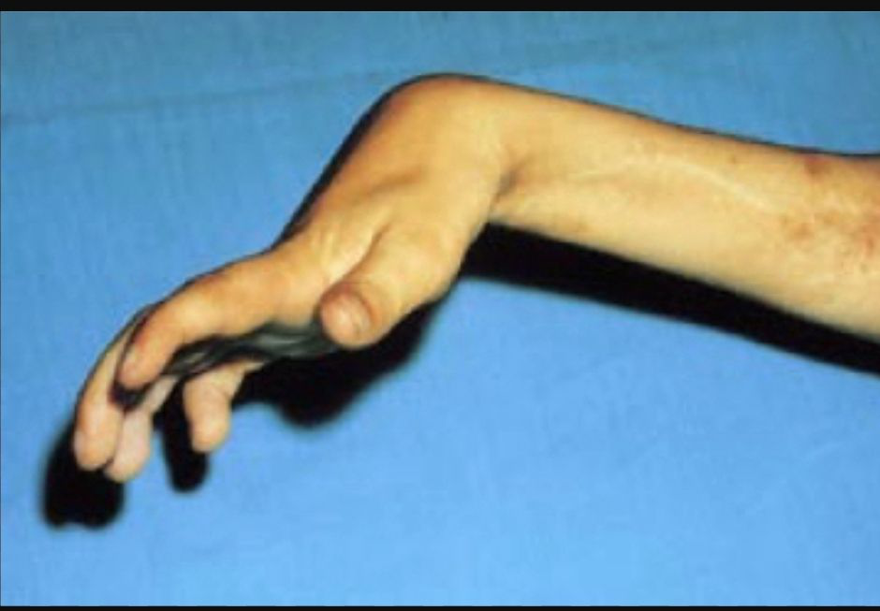
Volkmann's contracture is a permanent flexion contracture of the hand at the wrist,

Slide 17
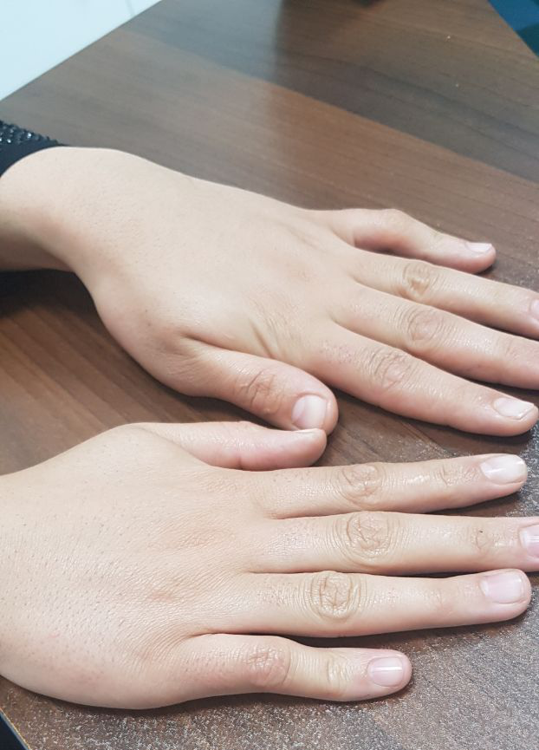
camptodactyly

Slide 18
prognosis
Dupuytren's disease has also been associated with increased mortality, particularly in patients who develop the disorder prior to age 60
Some patients have little incapacity for many years, and regression occurs in approximately 10 percent
fibrous bands form and radiate distally so that, ultimately, the fingers are contracted by the taut bands and hand function is impaired

Slide 19
A more severe and aggressive
“Dupuytren diathesis”
can affect other parts of the body:
the soles of the feet,
the popliteal fascia,
the knuckle pads,
the penis.
Symptoms frequently develop in these patients at an earlier age.

Slide 20
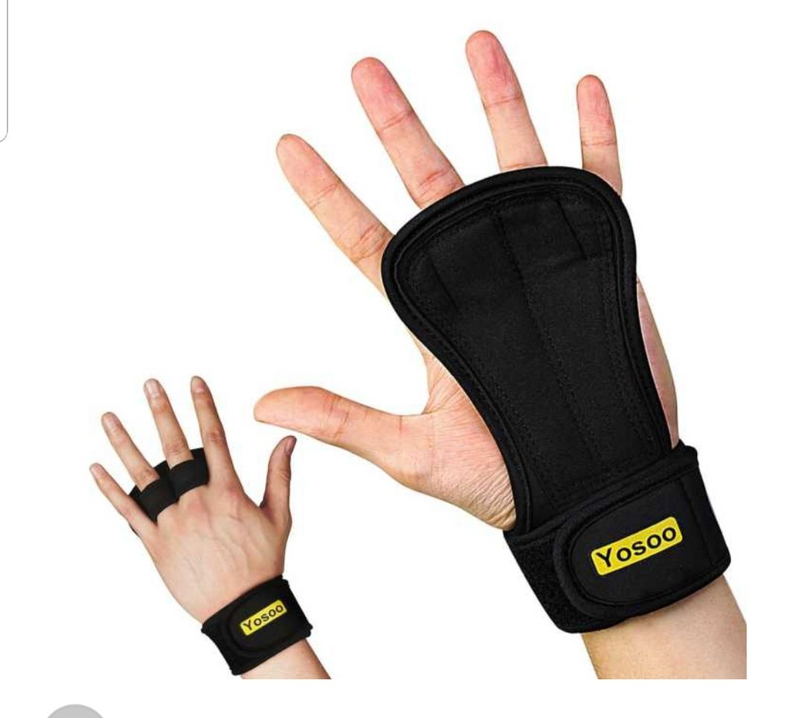
treatment

Slide 21
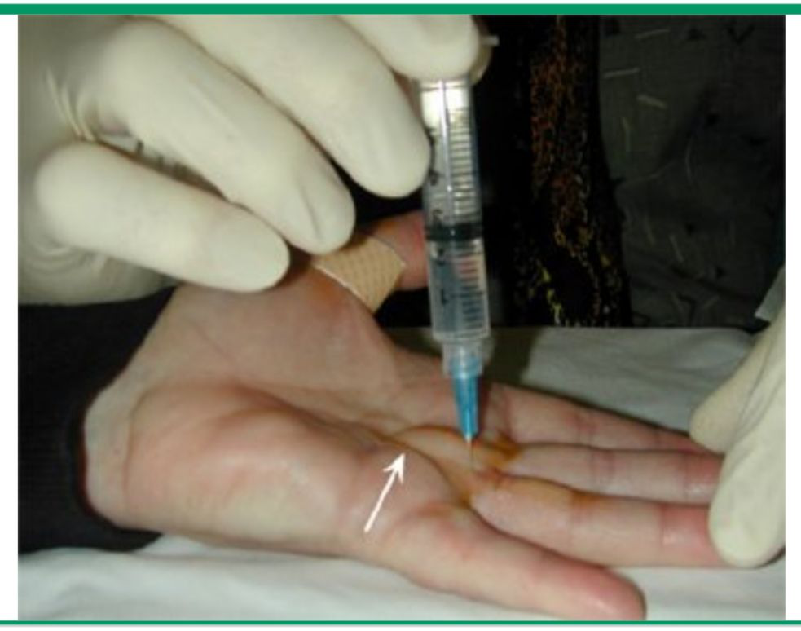

Slide 23
Trigger finger
stenosing flexor tenosynovitis
Patients with trigger finger initially describe painless snapping, catching, or locking of one or more fingers during flexion of the affected digit.
2%

Slide 24
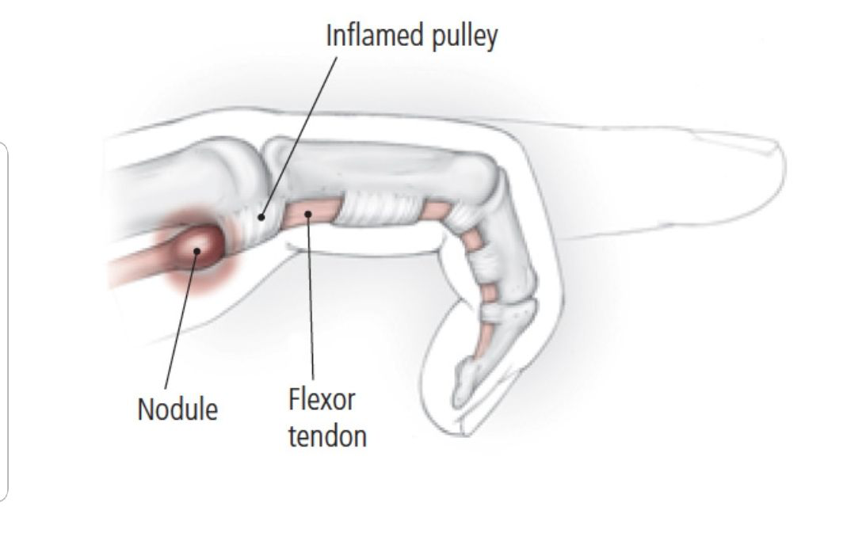

Slide 25
Patients with trigger finger initially describe painless snapping, catching, or locking of one or more fingers during flexion of the affected digit.
pain is localized over the volar aspect of the metacarpophalangeal (MCP) joint and radiates into the palm or the distal finger

Slide 26
etiology
Repetitive movement
DM- RA – gout
Female- 5-6th
Post CTS surgery

Slide 27
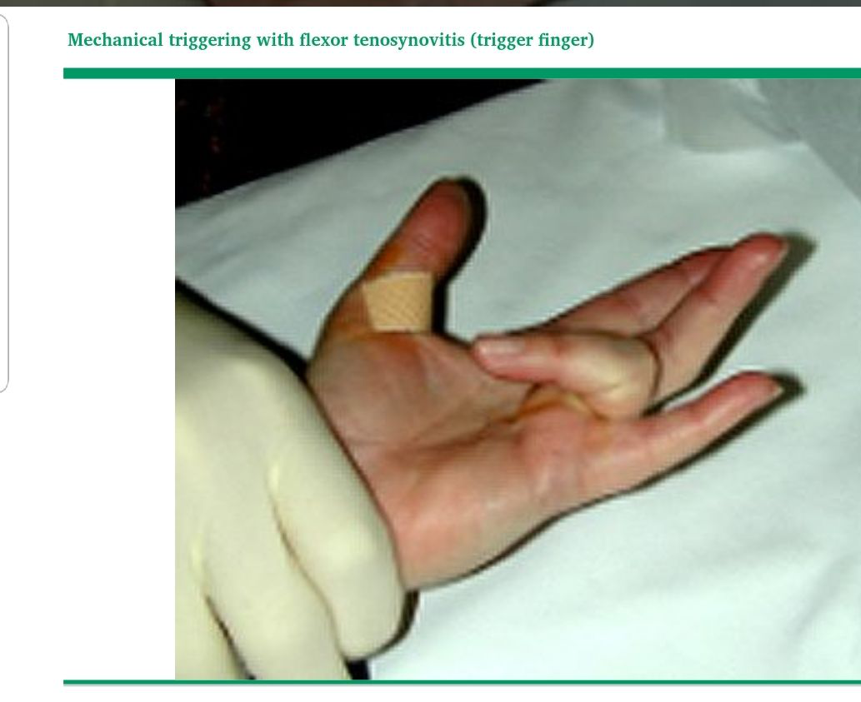

Slide 29
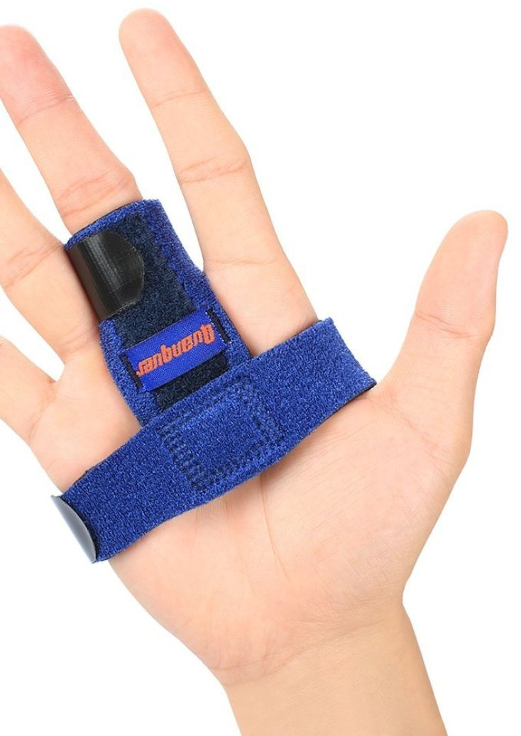

Slide 30
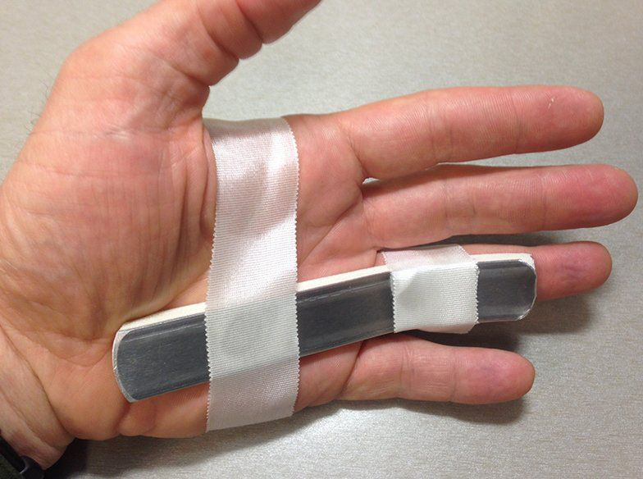

Slide 31
avoid potentially aggravating movements such as pinching or grasping of the fingers
93 percent of patients felt that their triggering had improved after 6 to 10 weeks of splint wear

Slide 33
lower success rate of injections is seen in patients with diabetes.

Slide 34
Surgery is suggested when pain and locking persist despite conservative therapy and at least one or two local glucocorticoid injections.
Outcomes of surgery may not be as successful in diabetics

Slide 35
